Slide 1


AWARD
show

Slide 2


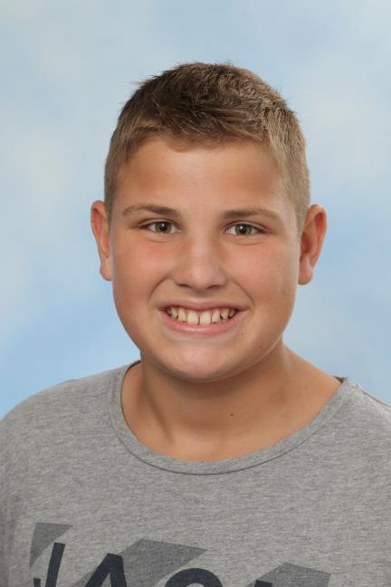
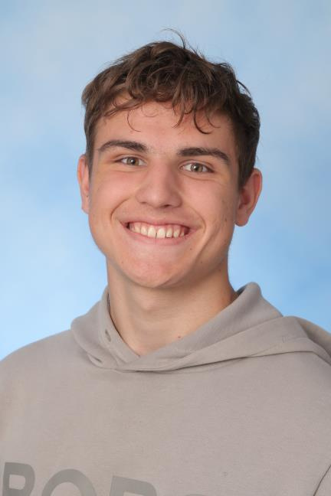
BRIAN VAN 'T VERLAAT
GRAMMAR GURU

Slide 3
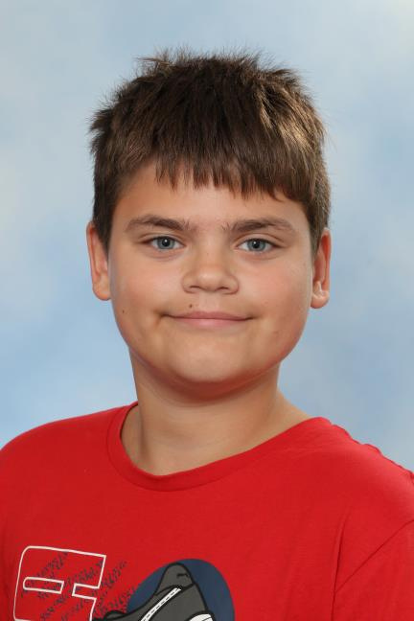
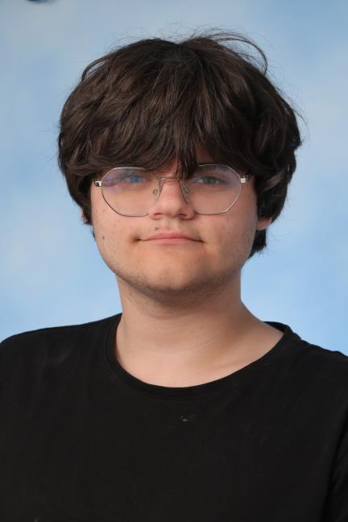
LUUK VAN DALEN
FUTURE WRITER

Slide 4
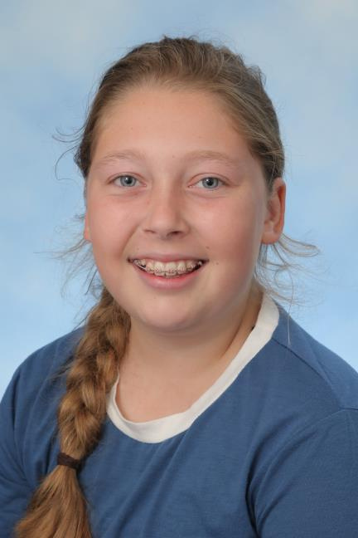
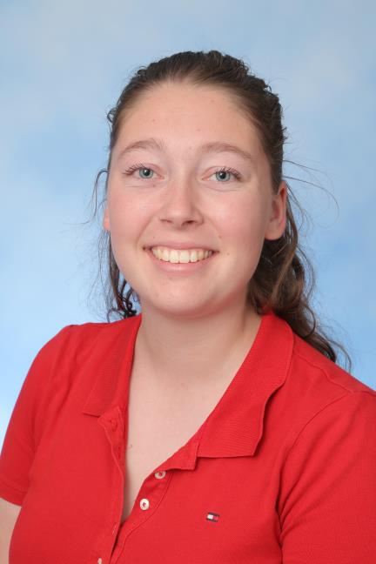
MADELIEF PAANS
QUEEN'S ENGLISH

Slide 5
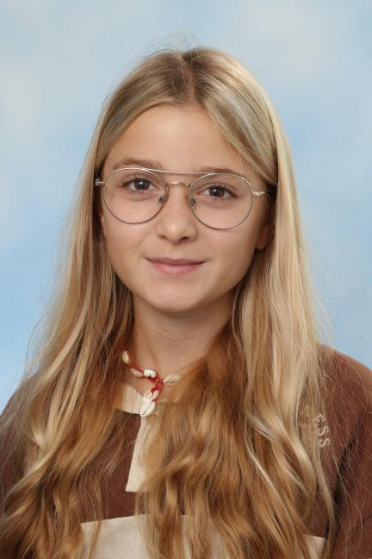
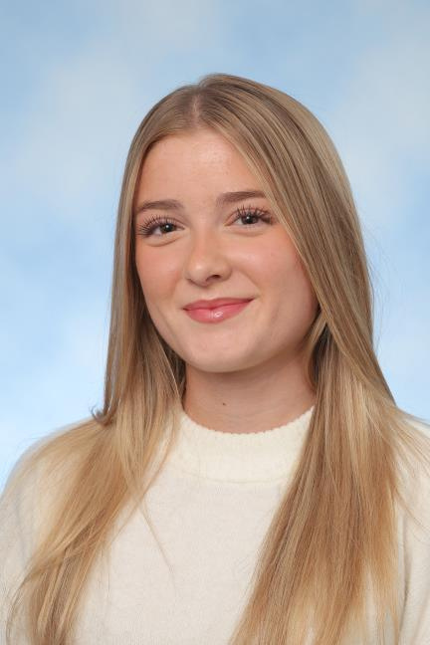
LIEVE DE BORST
GREAT LISTENER AWARD

Slide 6
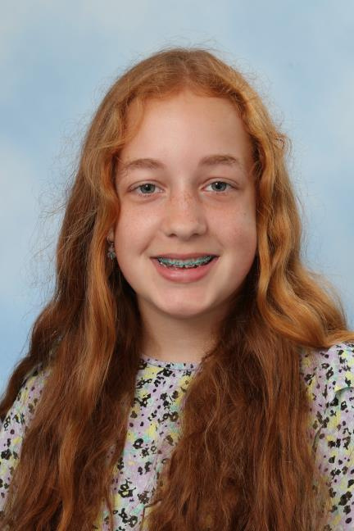
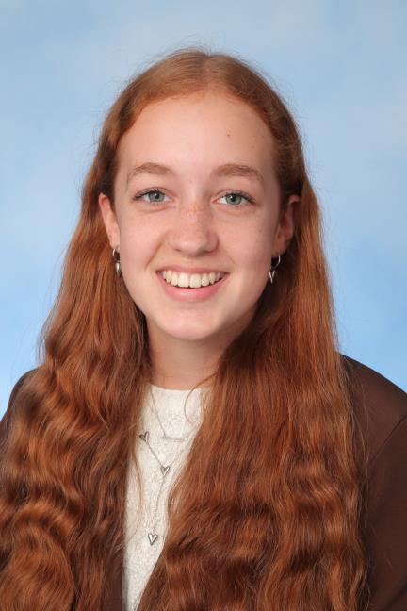
LOÏS LUBBERTSEN
MRS. MYSTERY

Slide 7
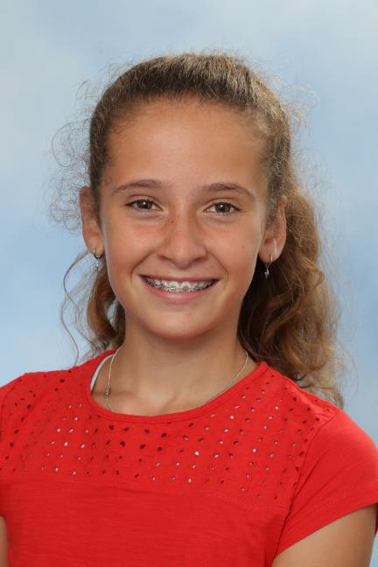
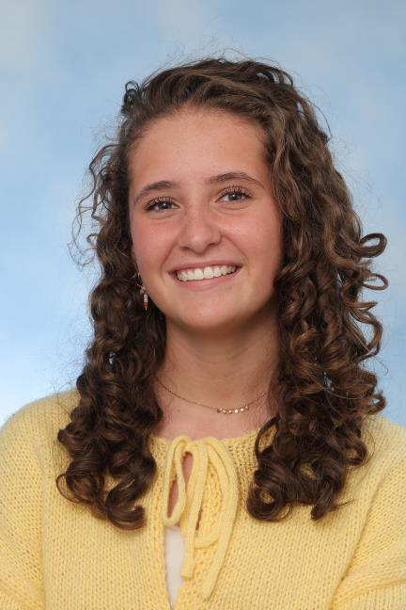
LOTTE WESTENENG
THE "WAIT, I HAVE A QUESTION" AWARD

Slide 8
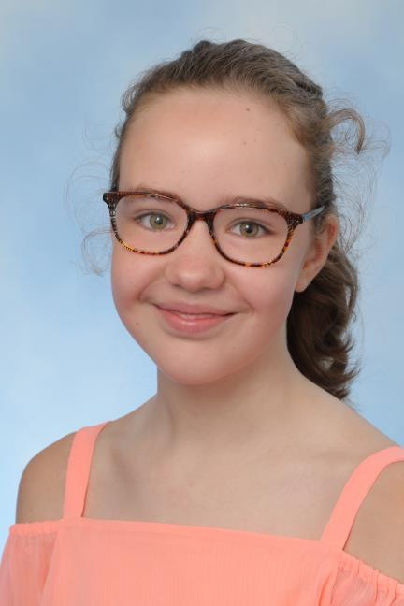
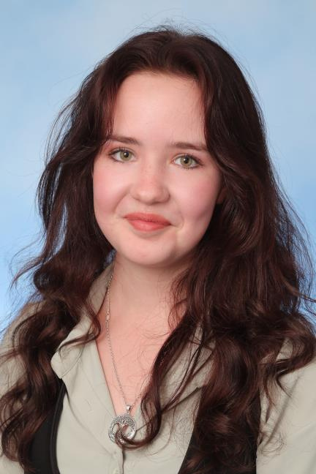
NATHALIE VAN KOOIJ
SILENT SHAKESPEARE

Slide 9
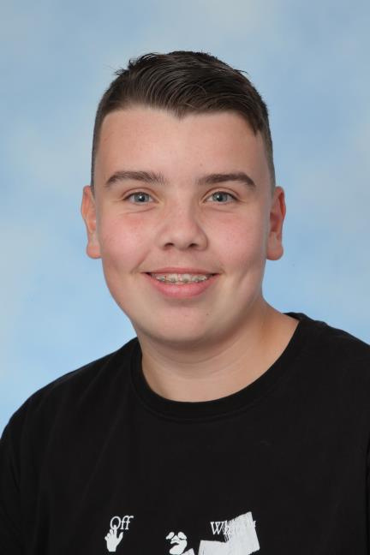
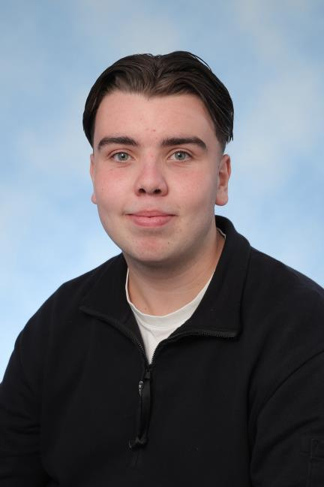
MATHIJS VAN 'T VERLAAT
OUT-OF-THE-BOX THINKER

Slide 10
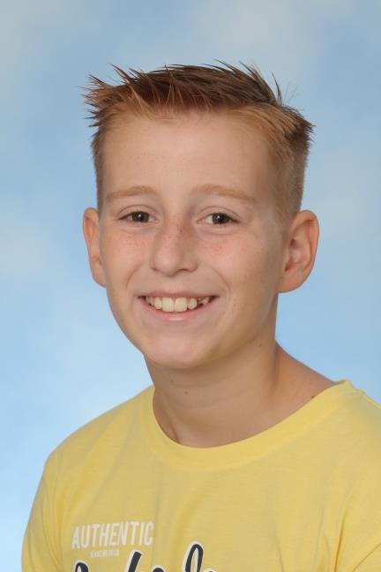
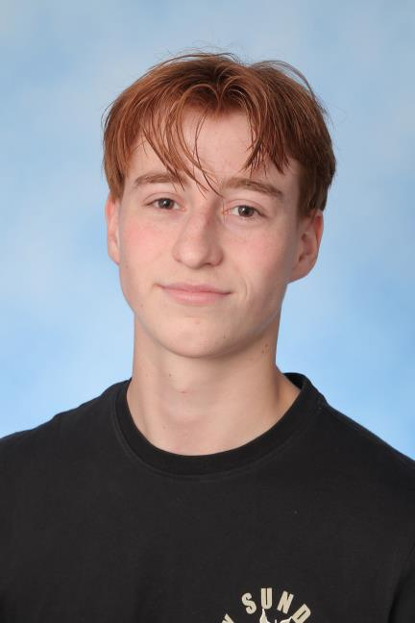
SEM VAN BREUGEL
NETFLIX NATIVE

Slide 11
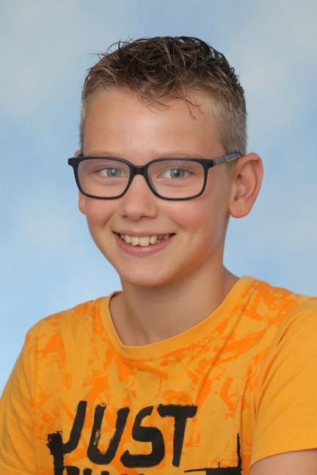
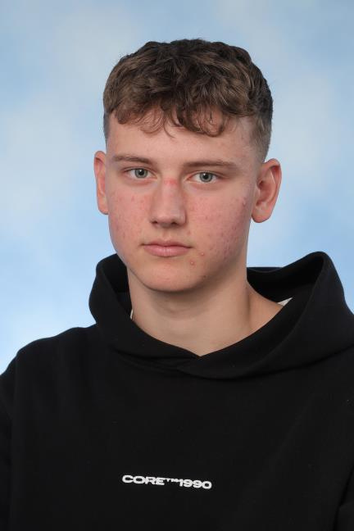
FRANK SPIERING
DRAMA KING

Slide 12
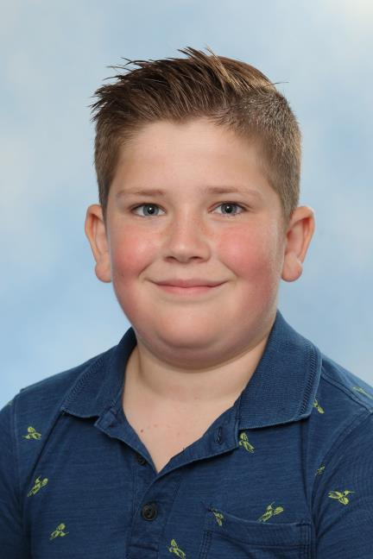
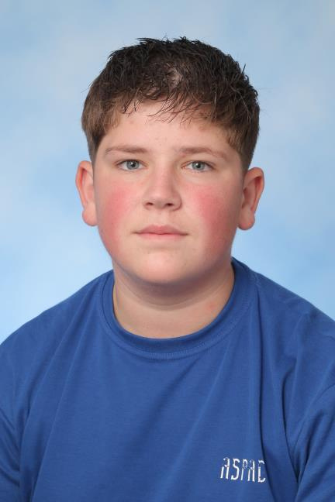
JANNICK DUIJZER
MOST IMPROVED STUDENT

Slide 13
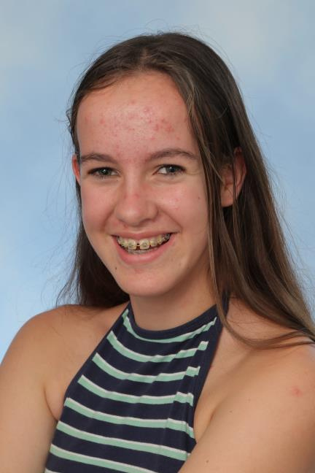
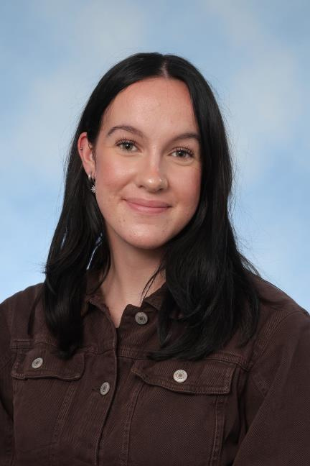
BENTE VAN BREUGEL
HIDDEN GENIUS AWARD

Slide 14
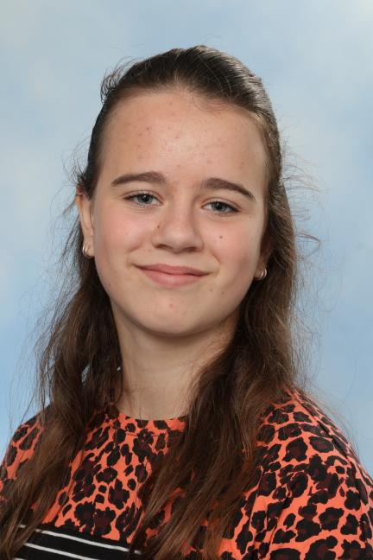
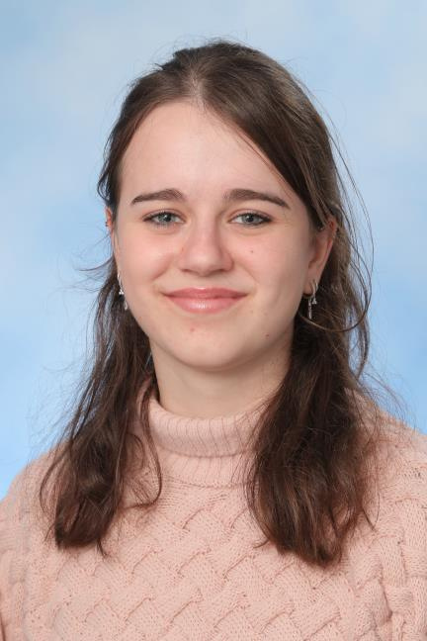
MARILOU VAN VUGT
ALL-ROUNDER

Slide 15
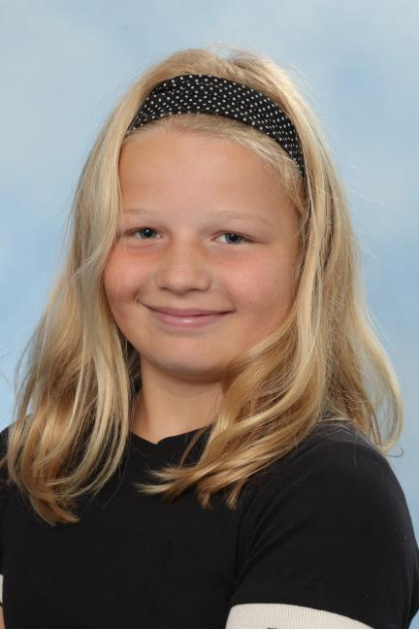
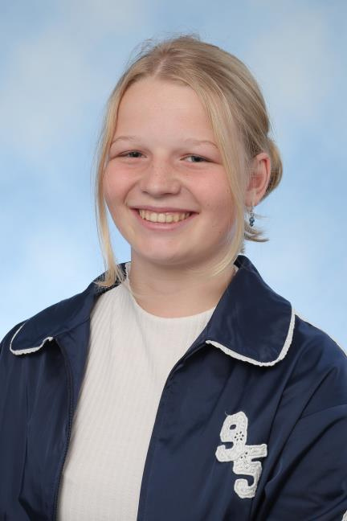
SILVIE VAN DER ZALM
WORD WIZARD

Slide 16
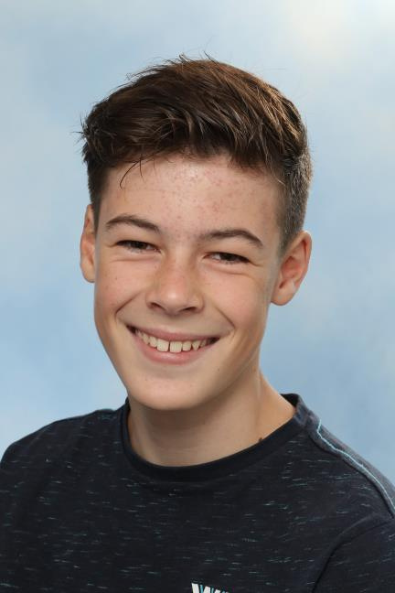
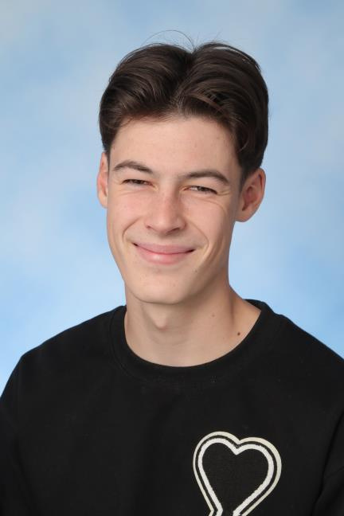
MORRIS KOCH
THE MASTER OF TITLES PRIZE

Slide 17
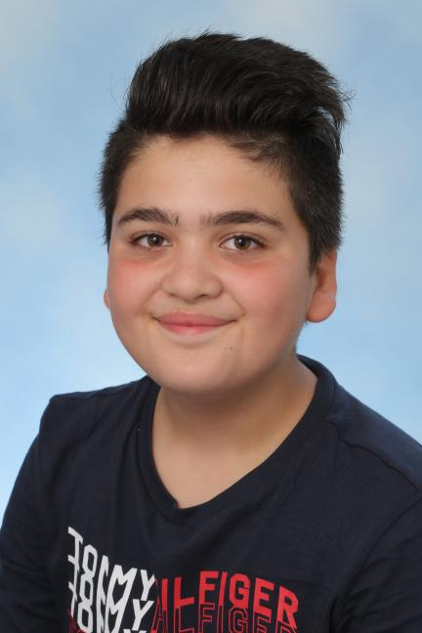
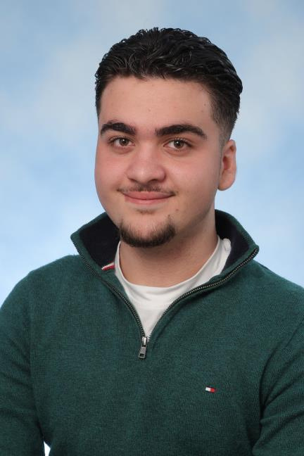
ARTIN GHASEMI
FUTURE CEO

Slide 18
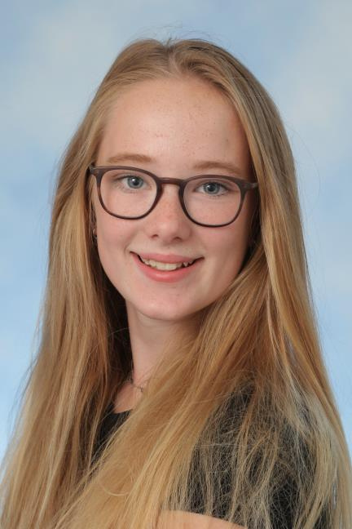
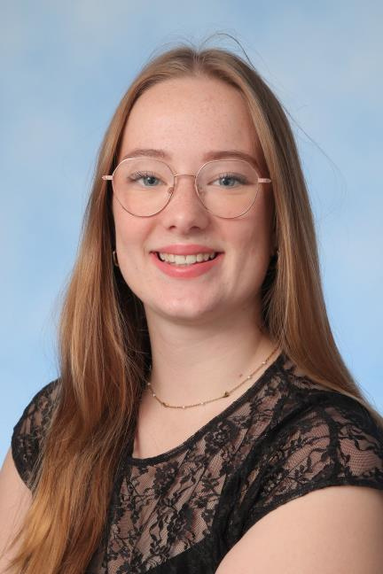
EMMA VAN DE WERKEN
FORMAL FLAIR

Slide 19
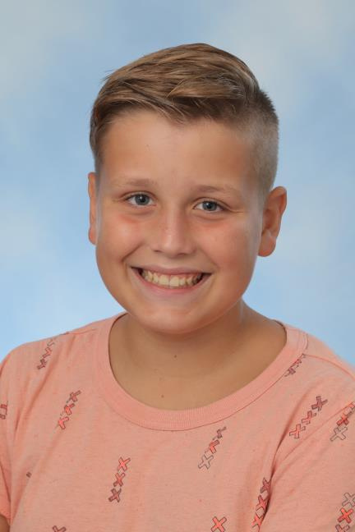
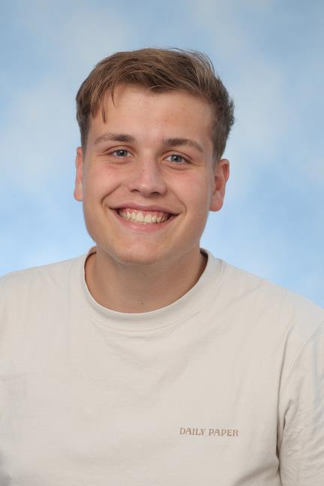
NIEK VOS
SMILE AMBASSADOR

Slide 20
THANK YOU
for Joining Us

